Slide 1
Application Demonstration
- DevOps Daemons
Kolkatta, December 2018
TCS Confidential

Slide 2
SCM

Slide 3
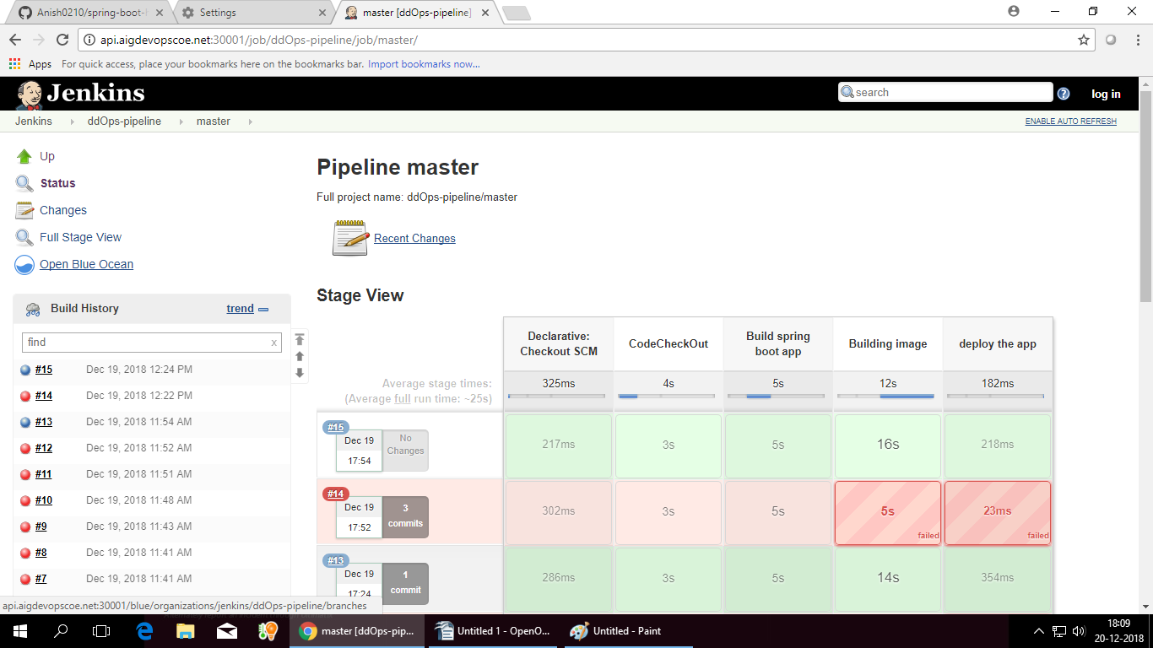
CI-Server

Slide 4
Binary-repo

Slide 5
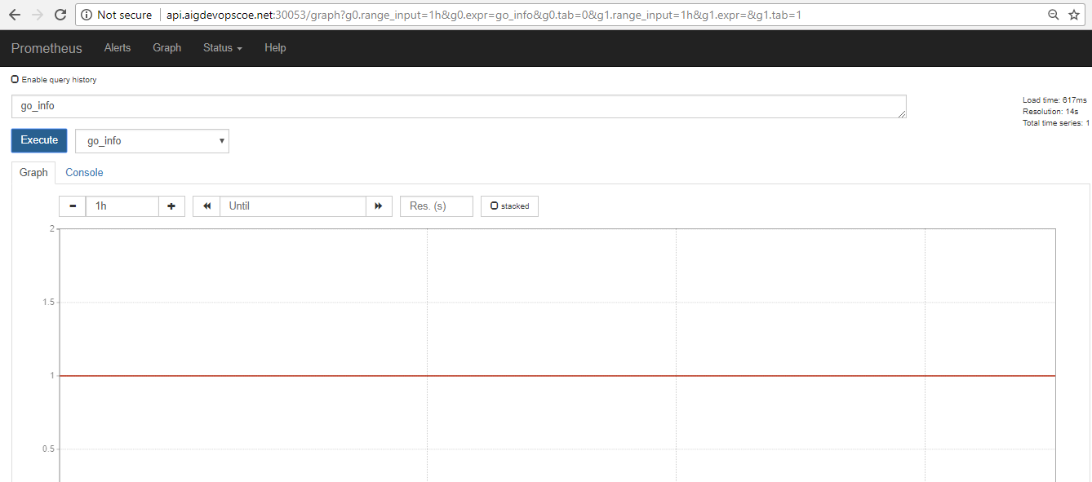
Prometheus-datasource

Slide 6
Graphana-UI

Slide 7
Metrics

